Slide 1

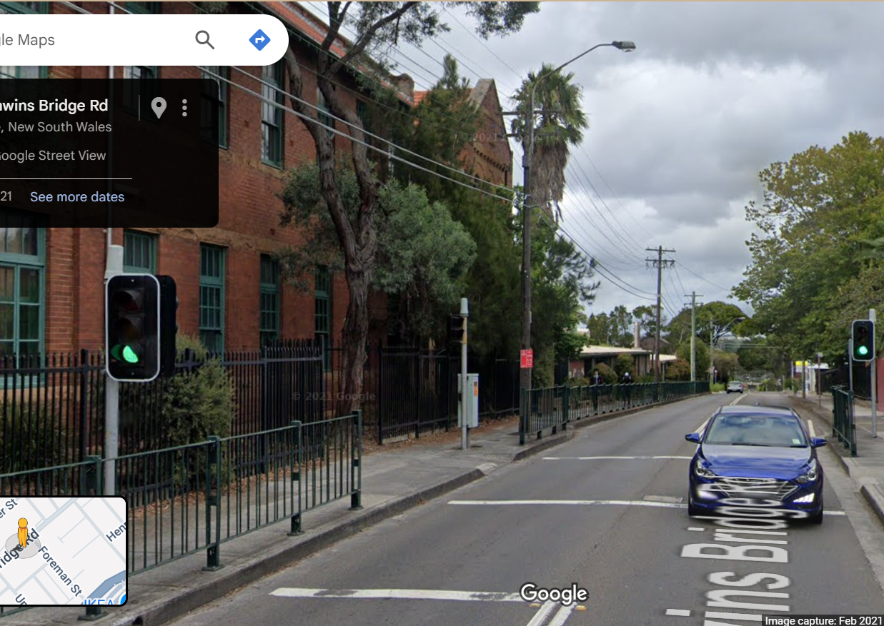
Pi Pico OOP Mini Project
Ben Jones
Tempe High School
Lecture 0
Notes:
This lecture focuses on the fundamental concepts
Of the Object Oriented Paradigm

Slide 2
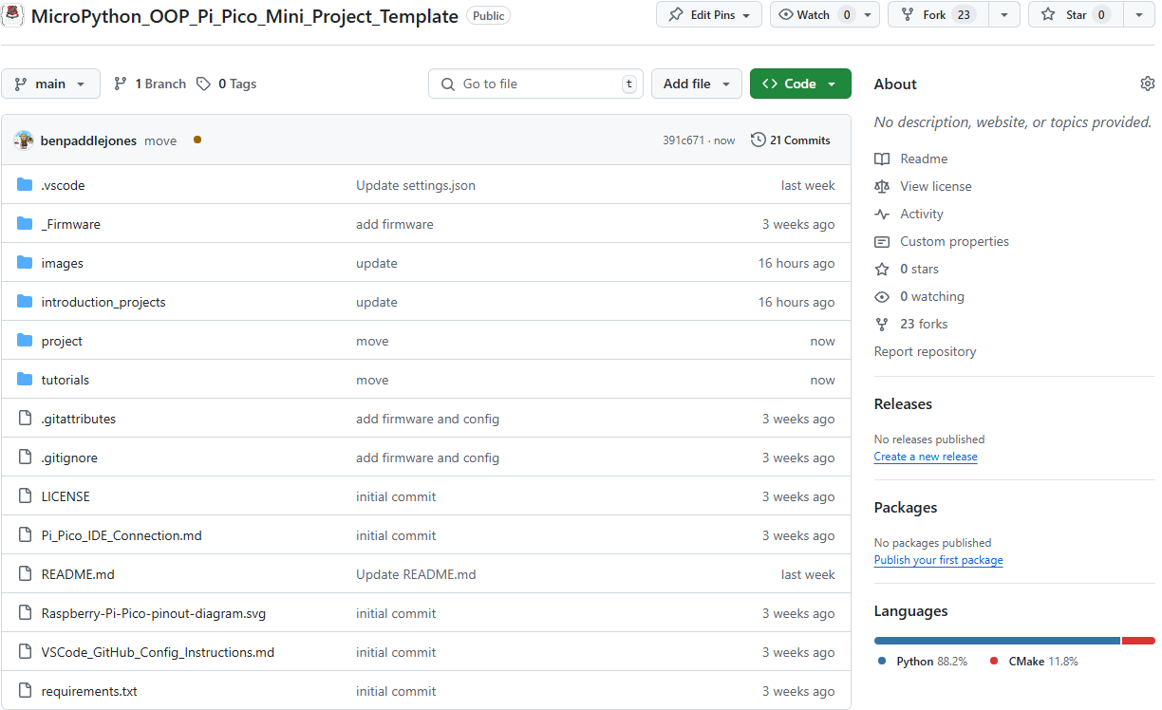
Fork Repo
Pi Pico Firmware
Instructions for
Introduction Projects
VSCode Project Folder
Preconfigured for Pi Pico Extension
Text Instructions for
OOP Mini Project
Pi Pico IDE Connection
Notes:
This is the source repository
Please fork the repository to your own github account
This folder contains the firmware and nuke unbricking firmware
This folder contains the documentation for the introduction projects
This folder folder is pre-configured for Pi Pico development is VS Code
This folder contains details on the concepts covered in these video tutorials
This file has help for connecting Pi Pico to different IDE’s

Slide 3
IDE
Wokwi
Arduino Lab Web Based IDE
Thonny
VSCode
Codespaces
Note:
This repository is optimised for VSCode.
I will Model both VSCode & Wokwi in this series.
See Pi_Pico_IDE_Connection.md for help with IDE’s and connection.
Notes:
Pi Pico works with all these IDE’s
I will be demonstrating Wokwi and VSCode in these lectures.
You can write code in CodeSpaces but
it will not connect to the hardware for upload
VScode requires the Pi Pico Extension

Slide 4
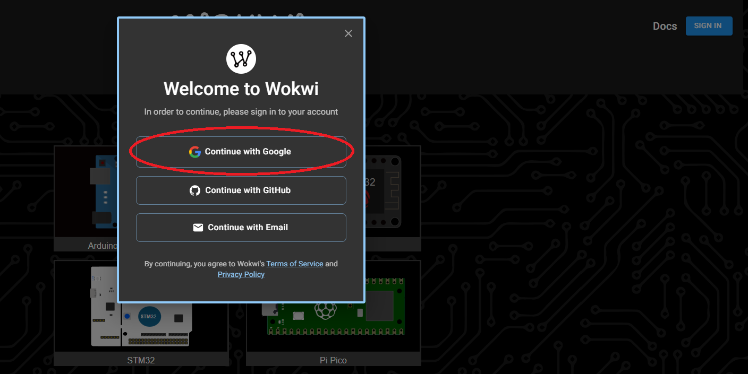
Wokwi https://wokwi.com/
Notes:
Wokwi is an Online simulator and IDE,
it great for simulations and unit tests.
All these projects including the OOP Mini Project
can be complete in Wokwi.
Although for your skills I encourage you
to physically wire them on a breadboard.

Slide 5
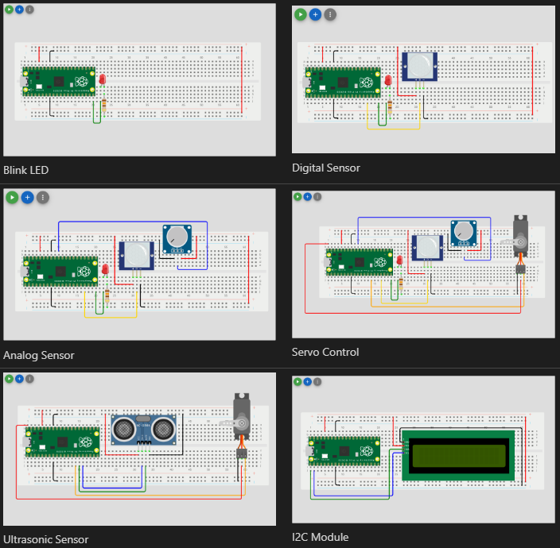
Introduction Projects
Notes:
The introduction projects are your first task after watching this video.
You are to follow the written instructions to build each project.

Slide 6
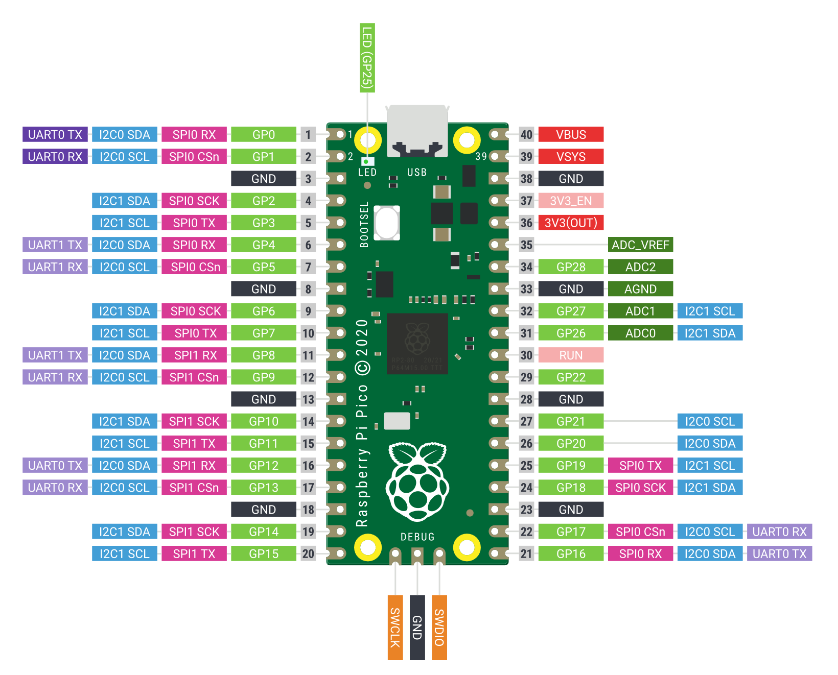
Common Mistakes
Programming GPIO Pin 3 but wiring to the 3rd Pin not GP3.
Incorrect polarity on an LED.
Connecting to the wrong row on a breadboard.
Connecting an analogue sensor to the GND rather than the specific analogue ground AGND.
Not uploading the 2IC Libraries either to the Pi Pico or to Wokwi.
Overcurrent as the Pi Pico and most sensors are 3.3v sensitive. Only motors should be connected to the VBUS (5v). If a sensor is connected to the VBUS, it will return 5V to the GND, causing an overcurrent situation.
Notes:
The common mistakes you should be aware of are
Programming GPIO Pin 3 but wiring to the 3rd Pin not GP3.
Incorrect polarity on an LED.
Connecting to the wrong row on a breadboard.
Not connecting the analogue sensor to the analogue ground AGND.
Not uploading a Library (2IC).
Overcurrent on a sensor. Most sensors are 3.3v sensitive.
Only motors should be connected to the VBUS (5v)

Slide 7
Simple Open Loop Control System
Can you see the controller?
Notes:
The Mini Task is to model this control system
using the Object Oriented Paradigm, and
the light blue box is the controller these
are usually digital mechanical control systems.

Slide 8
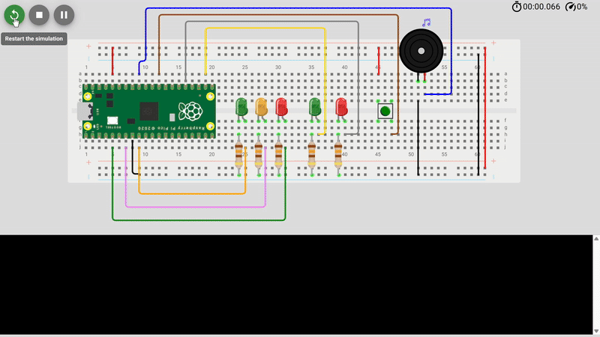
Notes:
This animation will show you the prototype running as a full system.
You will see the button press triggers a control system state change,
the system then loops through a series of states
before returning to the idle state

Slide 9
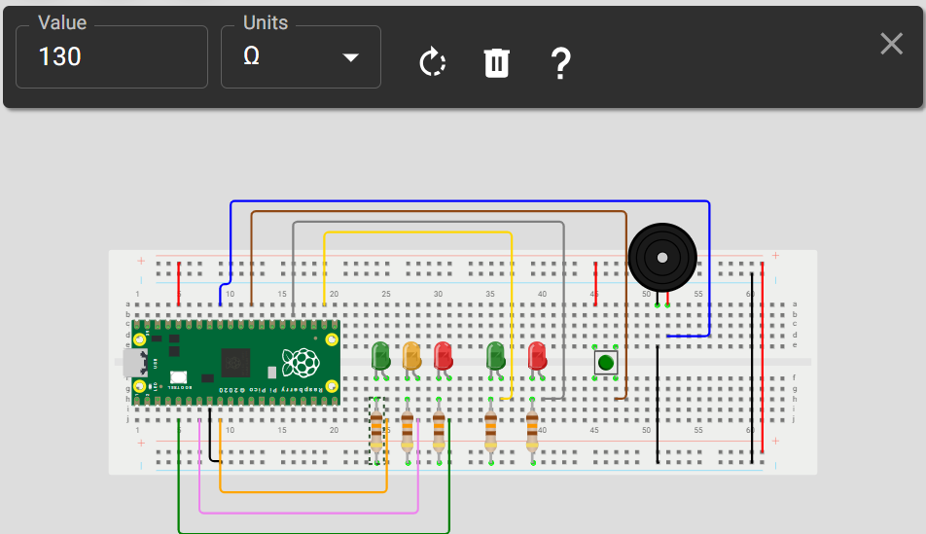
Components
Breadboard
15x Jumper leads
Pi Pico
1x Momentary switch
5x LED
1x Piezo buzzer
5x 130Ω resistors
Notes:
These are the components we will use
If physically building the circuit, it is suggested
You get all the comments before you begin.
If using Wokwi, make sure you change the
resistors to 130Ω’s or the resistance
will be too high and they may not
Illuminate.

Slide 10
Pin Allocation
Pin
GP3 | Red LED
GP4 | Keyboard Interrupt
GP5 | Amber LED
GP7 | Red LED
GP17 | Flashing Green LED
GP19 | Flashing Red LED
GP22 | Button signal
GP27 | Piezo Buzzer
GND | Circuit Ground
3V3 | Button logic voltage
Notes:
These are the Pi Pico Pins allocated for this project
For ease of following this project, it is suggested
You use these pins.

Slide 11

When you see this symbol,
press pause and implement it!
Notes:
Throughout these tutorials when
You see this pause symbol it means
You need to press pause and implement
It!

Slide 12
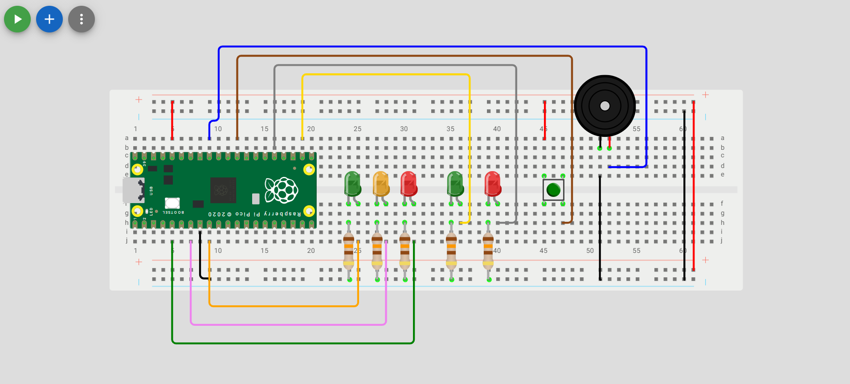
Wiring
Notes:
So now you need to press pause and wire your project.
When you have finished wiring it,
you are ready for the Lecture 1.
Were will start by unit testing your
prototype

